Slide 2
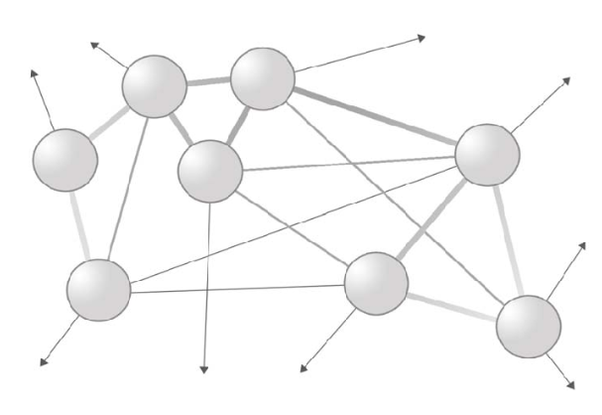


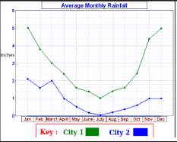
WEATHER MONITORING SYSTEM (NODAL NETWORK)
SENSING NODE (client 1) Autonomous Block
Solar panel
Wifi
Power unit
Battery
PVT nwk
Micro-controller
Sensor 1.Temprature 2.Humidity 3.Altitude
HUB (Server)
Sensor
230v AC
PVT nwk + Internet
Wifi
CLOUD (internet)
SENSING NODE (client n) Autonomous Block
Power unit
Solar panel
Micro-controller
wifi
Power unit
Battery
PVT nwk
MOBILE
Micro-controller
Sensor 1.Temprature 2.Humidity 3.Altitude
LCD DISPLAY
Sensor

